Slide 1
UNFOLD Assignment 4: Concept Video
STANFORD CS 147: INTRODUCTION TO HUMAN-COMPUTER INTERACTION
SARAH JACOB, STEVEN LE, KRYSTAL LI, LAUREN YU

Slide 2

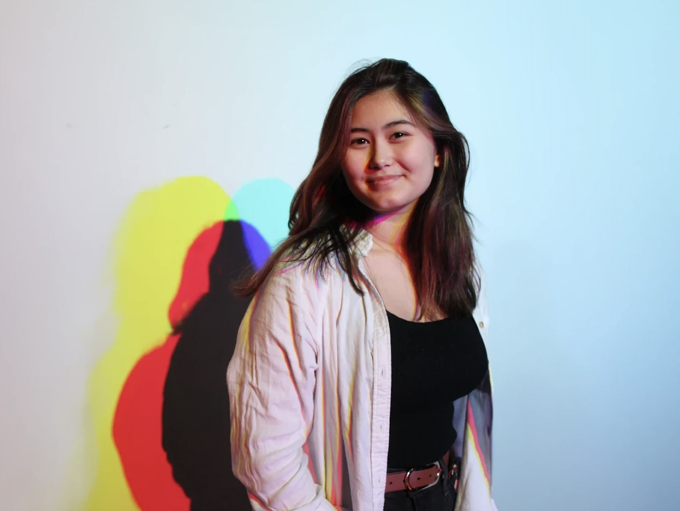


Team Members
Krystal Li
Junior
Symbolic Systems, HCI
Miami, FL
Sarah Jacob
Senior
Design, AI + UX
Brick, NJ
Steven Le
Senior
Computer Science, HCI
Phoenix, AZ
Lauren Yu
Junior
Computer Science, HCI
Brea, CA

Slide 3
Roadmap
1
2
3
4
5
Our Solution
Market Research
Values & Tasks
Storyboard
Our Video

Slide 4


Problem
People often struggle to stay accountable with their tasks because they find them mundane, difficult to stay engaged with, and lacking in shared support.
Solution
An app that incentivizes task completion through narrative-driven updates that evolve their personalized avatar, reflecting their progress and accomplishments.
Notes:
. Problem/solution overview
a. 1-3 sentences total
b. Who the primary user is
c. Problem you are tackling
d. Brief synopsis of your proposed solution

Slide 5
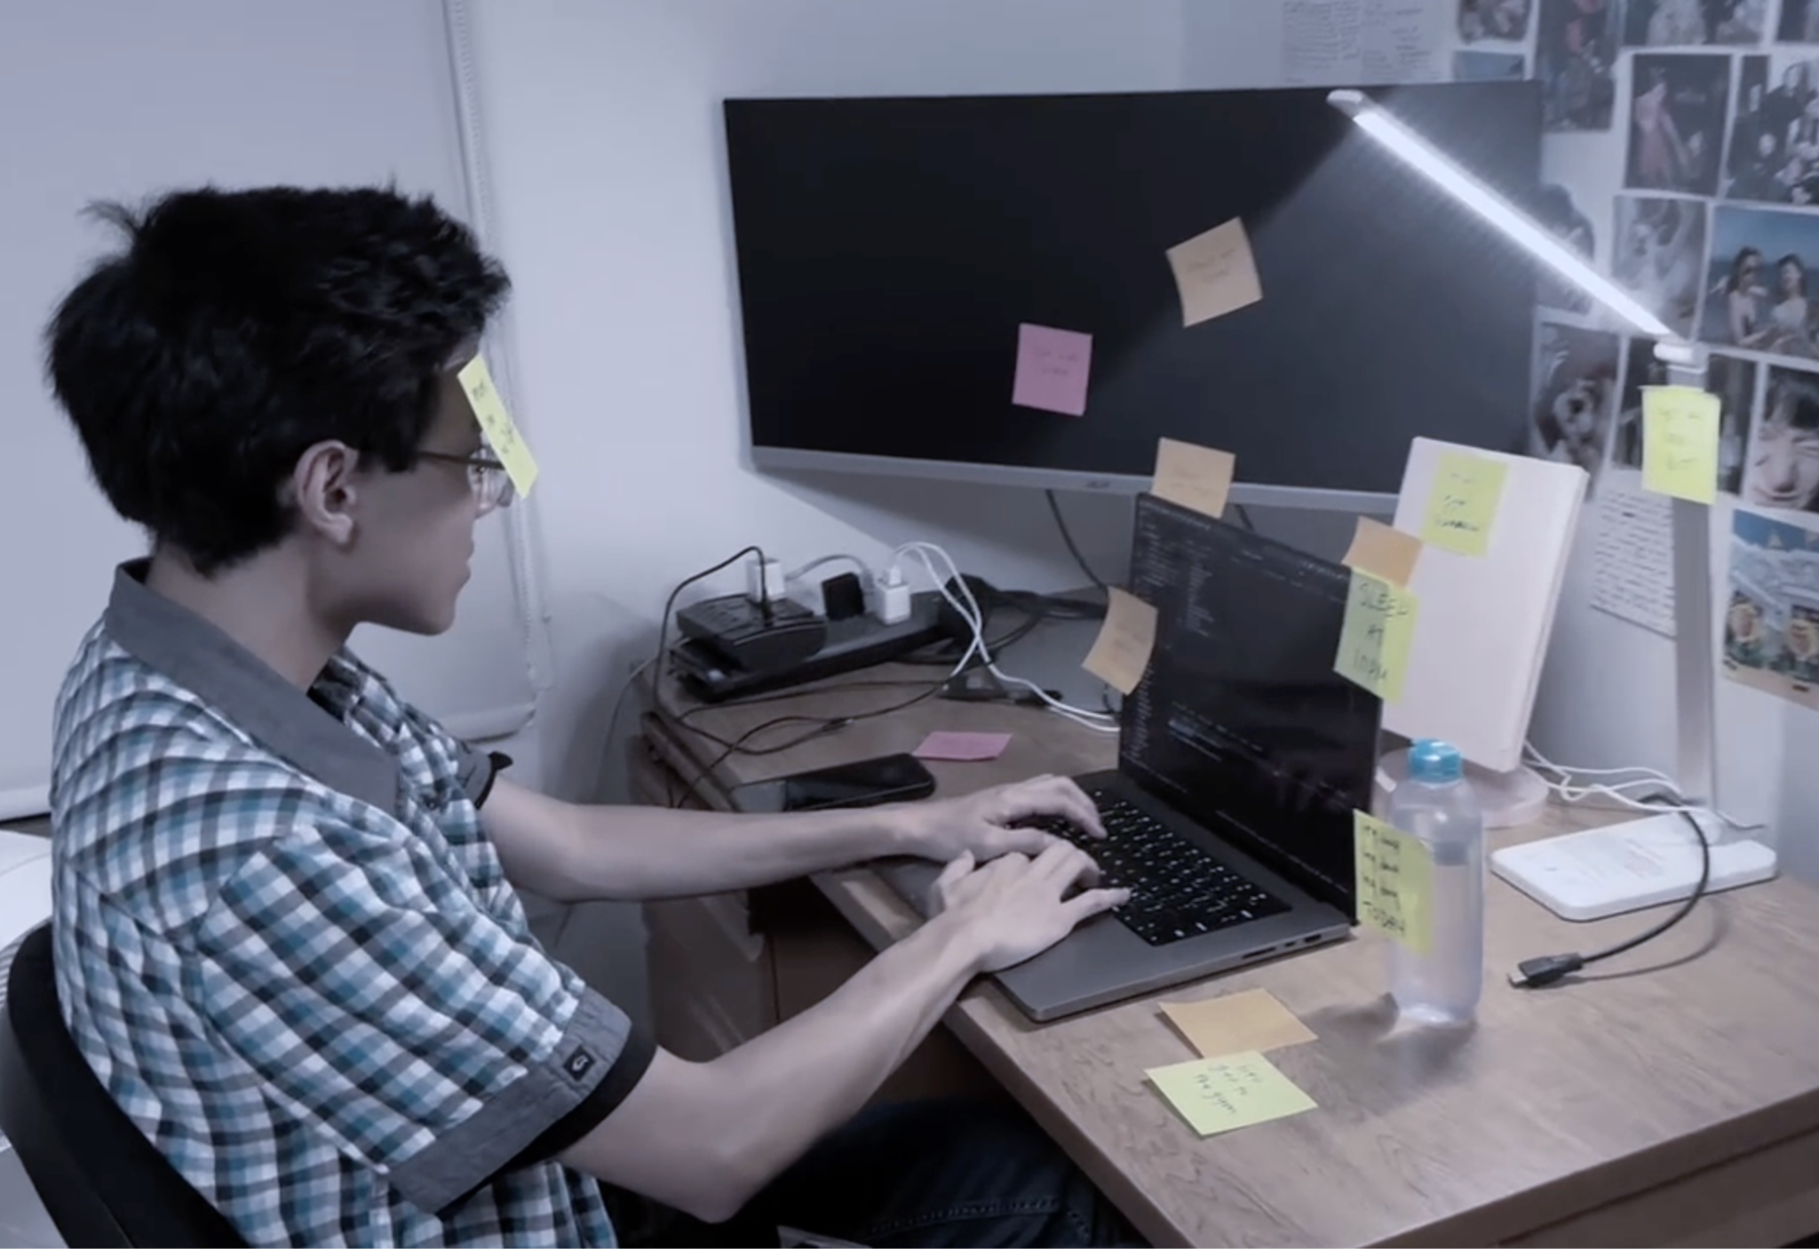
Primary User
Busy professionals, students, and anyone looking for a fun and engaging way to stay productive
People who benefit from visualizing their progress and enjoy personalizing their experience through gamified elements
Notes:
. Problem/solution overview
a. 1-3 sentences total
b. Who the primary user is
c. Problem you are tackling
d. Brief synopsis of your proposed solution

Slide 6
Unfold
Your tasks, your story—watch it unfold.
Unfold is a narrative-driven task management app that turns everyday tasks into an engaging adventure. With each completed task, users earn XP to evolve their personalized avatar and unlock new story levels.
Healthy Behaviors Studio
October 2024
Notes:
Project name and value proposition
a. How did your team land on the name?
b. One-liner value proposition that conveys what customers get out of your product (e.g., Stripe “Payment infrastructure for the Internet”)
c. Sanity check: could your value proposition be applicable to many other apps or is it particular to yours? You want the latter.

Slide 7
Deciding Our Name
We chose the name “Unfold” for a variety of reasons.
At its core, it’s a narrative-driven concept, transforming everyday tasks into a larger, ongoing story, which aligns with the idea of a story "unfolding" over time
The motivation for completing tasks is to learn more story elements and “Unfold” captures that cliffhanger effect we hope to achieve
It conveys a sense of discovery, making task completion feel like an exciting, evolving adventure rather than just a routine activity
Overall, “Unfold" is concise, memorable, and resonates with the idea of continuous progress, making it easy for users to connect with the app’s core purpose.

Slide 8
Value Propoposition
Unlike typical task management or productivity apps, Unfold stands out through its blend of personal productivity with an evolving narrative. While many apps use basic gamification to motivate users, Unfold uniquely focuses on a story-driven experience, compelling users to complete tasks not just for points or badges, but to reveal the next chapter of their personalized story. This provides an added layer of emotional engagement and curiosity that keeps users invested in finding out: “What happens next?”
Sanity Check: This concept fills a unique niche because it uses narrative as the main way to engage users, unlike most gamified apps that focus on rewards like badges, ranks, or streaks. The key difference is Unfold’s continuous storyline, which motivates users beyond simple productivity goals. No other task management apps emphasize storytelling as the primary motivational tool, making Unfold a truly distinct offering.

Slide 9
Market Research

Slide 10
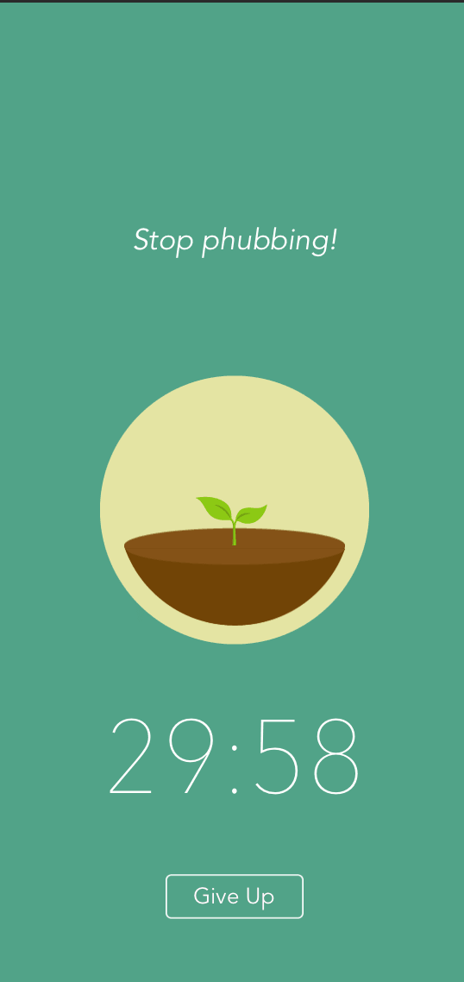
Forest
Forest helps you stay focused by putting down your phone and utilizing the pomodoro method as you grow digital plants.
What works for our problem space:
Progress is rewarded (e.g. plant is growing)
Visualize progress by growing a digital forest
Short bursts of productivity
Real-world impact by planting trees with Trees for the Future
What doesn’t work:
Narrow scope; focused only on reducing phone screen time
Doesn’t help users set up specific goals
App format can cause users to be drawn to their phone and get distracted

Slide 11
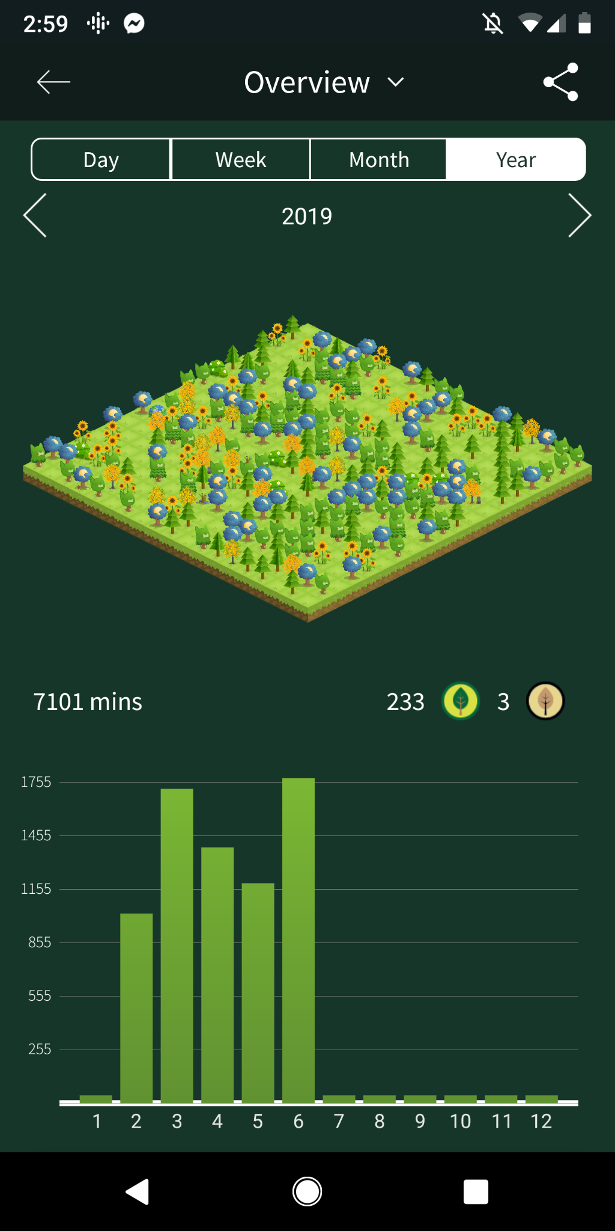
Forest
What we can take away:
Users are swayed by visualizations of their progress, especially when seeing how large their forest has grown.
One can facilitate a user’s sense of emotional attachment to a virtual pet or plant, especially with appealing visuals.
We can encourage activity productivity and completion of tasks by digitally rewarding the progress users make.

Slide 12
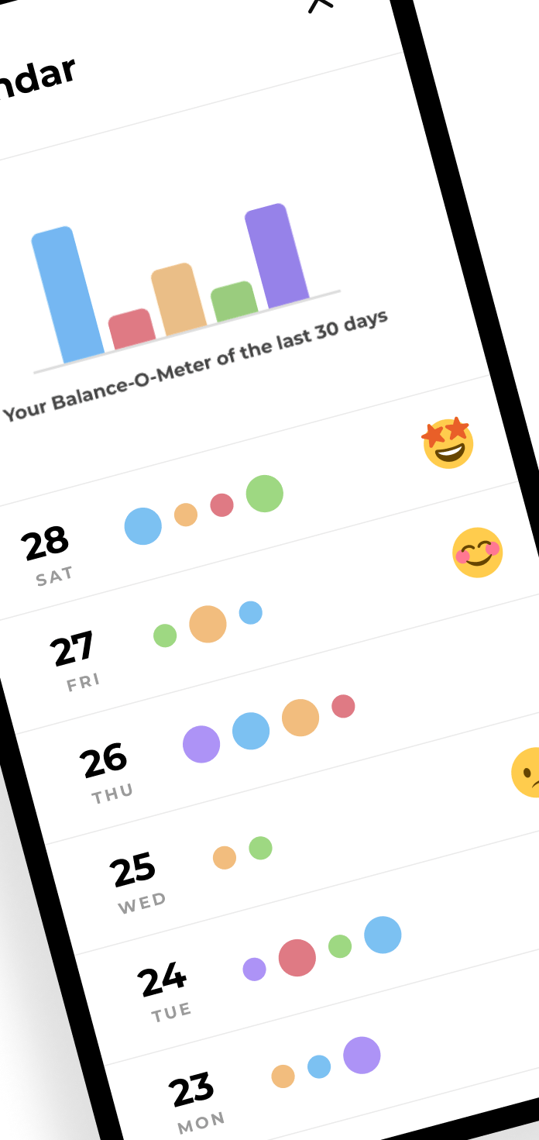
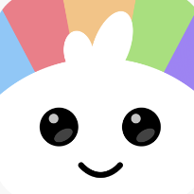
Blobby
Blobby is a habit-tracking app that helps you develop healthy habits in key aspects of your life, while also taking care of a cute buddy.
What works for our problem space:
Simplicity in adding necessary tasks
Breaking task goals down into more doable parts
Avatar personalization as as the users progress
No streaks focus, progress is not lost for missed days
What doesn’t work:
Puts burden on user to stay engaged with the app
Paid avatar upgrades
Stagnant achievement levels

Slide 13
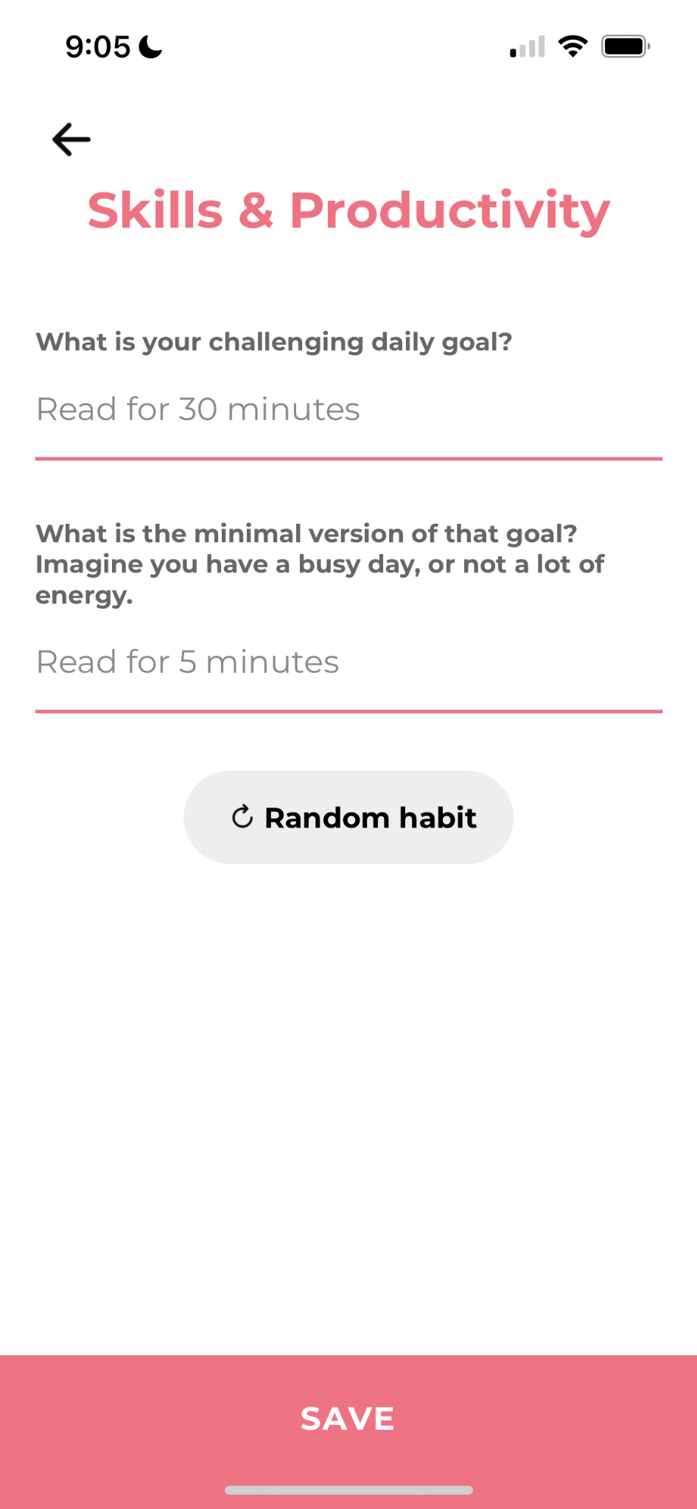
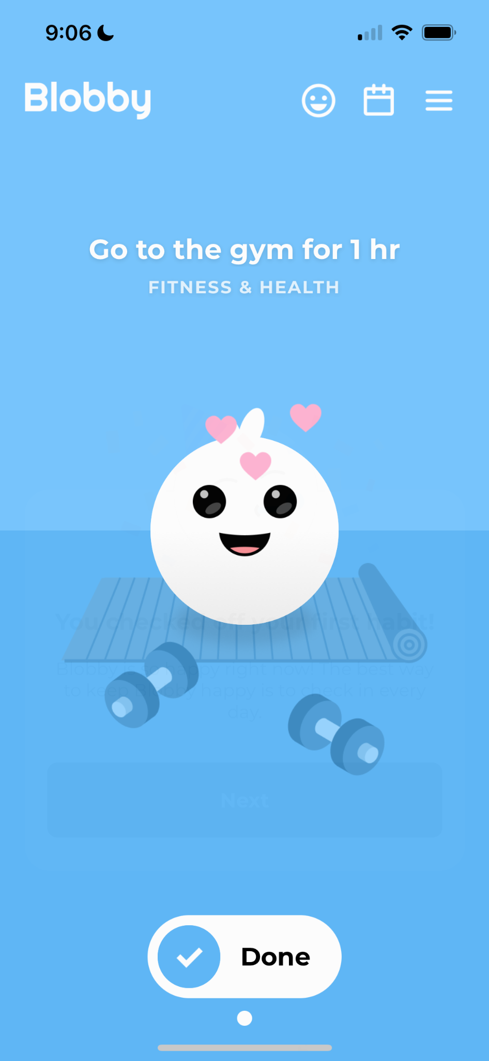
Blobby
Blobby promotes balanced, sustainable habit formation. It focuses on consistency and self-improvement. The app includes wellness tools like journaling & breathing exercises.
What we can take away:
The use of range goals encourages sustained habit formation by offering flexibility.
Avoiding punishment for missed tasks, as Blobby does with the lack of streaks, keeps users motivated without creating pressure.
Purely aesthetic upgrades may not be engaging for users long-term.
Individual-focused experiences may limit motivation of users without a sense of shared goals or competition.

Slide 14
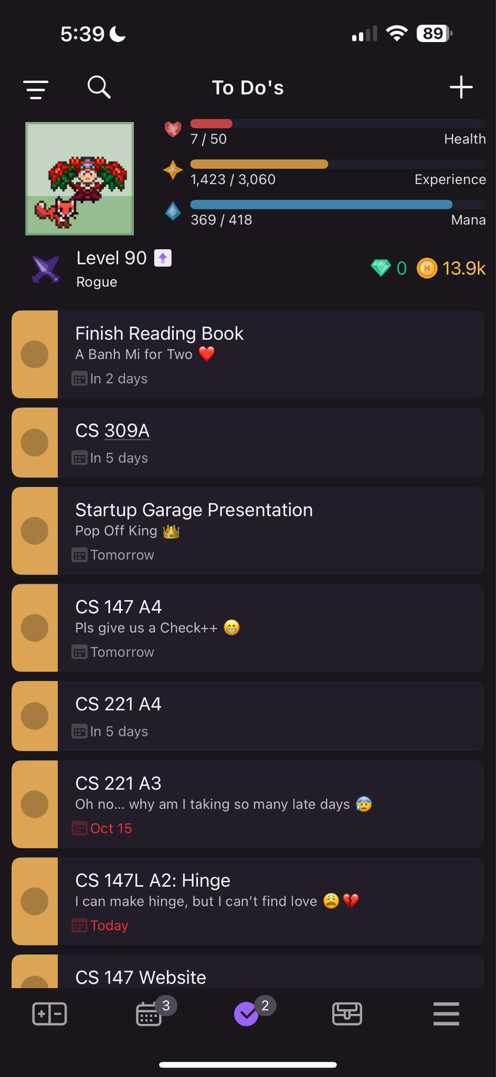
Habitica
Habitica uses retro RPG elements to gamify your tasks and goals.
What works for our problem space:
Habits/Dailies/Todo list breakdown
Party up with close friends/family - max 30 people per party.
Gamified leveling system
Buying character customizations
No penalty when missing a day
What doesn’t work:
Hard to stay committed when leveling up alone
Joining and finding a party is very confusing
Takes a long time to add todo list tasks

Slide 15
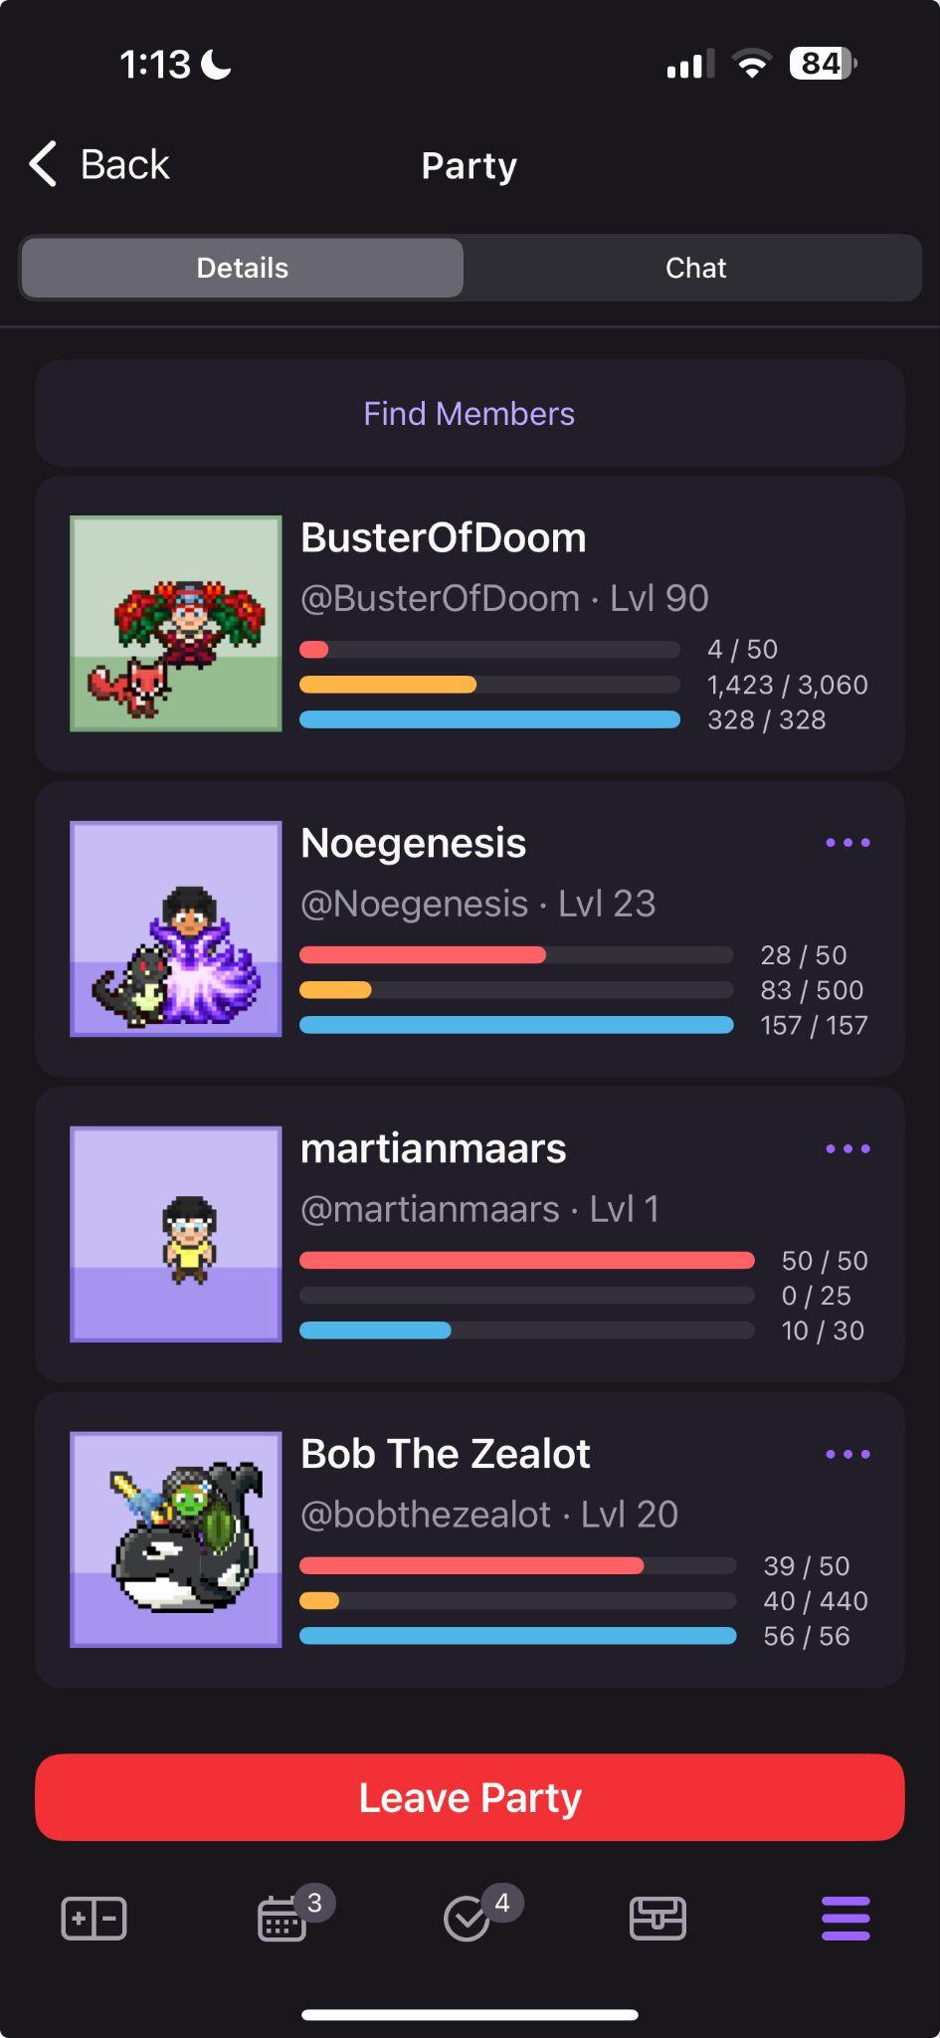
Habitica
What we can take away:
RPG Gamification works best when in a party setting. Our app will work for both solo and party players by involving an overall narrative and invoking a sense of adventure.
Rewards add an extrinsic motivation to complete tasks
People don’t like being punished. When not completing a task on time, there isn’t a explicit negative that occurs—just a less positive outcome.

Slide 16
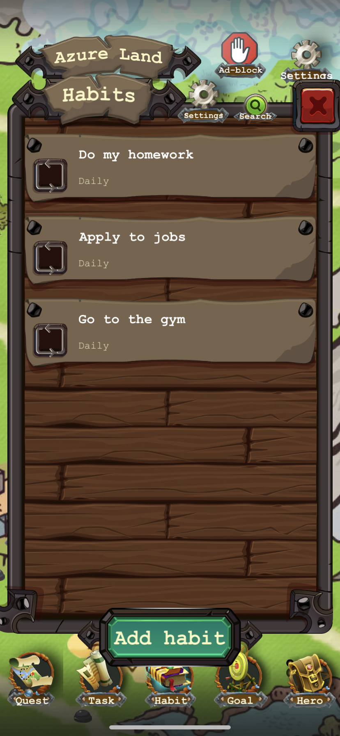
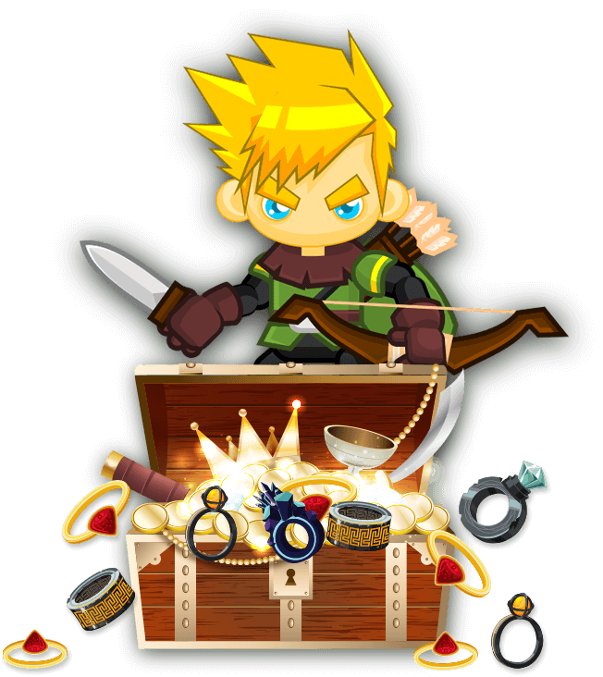
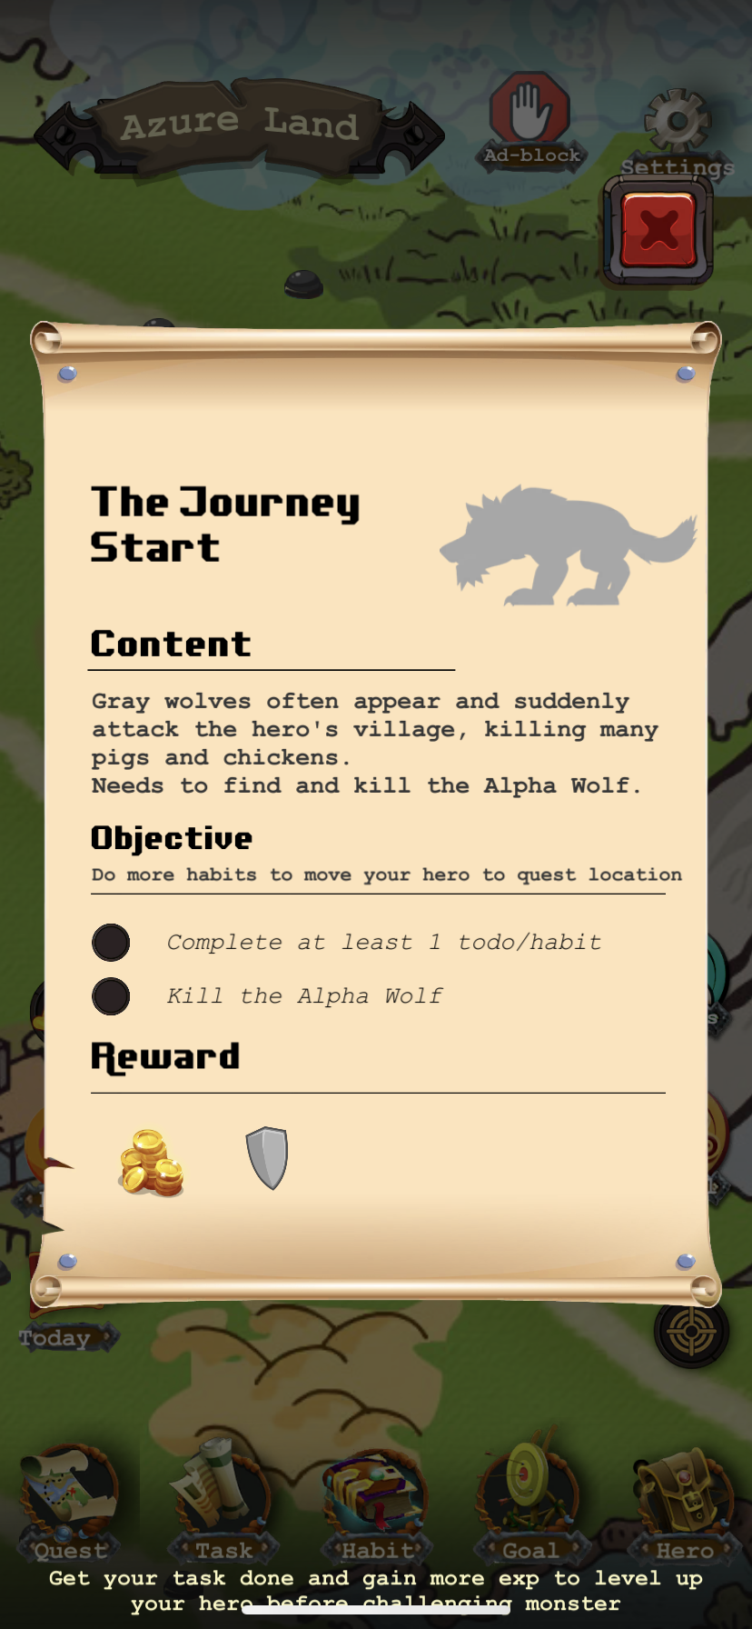
Habit Hunter
Habit Hunter helps you build a habit of creating and managing your goal logically and effectively.
What works for our problem space:
Structured goal-setting and habit management
Built-in reminders and notifications
Gamified elements like rewards and leveling up
Can customize your character

Slide 17
Habit Hunter
What doesn’t work:
Distracting features like battling monsters can sometimes detract from actual productivity and goal completion
Potentially visually overstimulating and complex, as the app’s interface may overwhelm users, making it harder to focus on tasks
Many features require tutorials
Leaderboard-centric motivation since points and leaderboards have more focus than tasks
The app limits interactions to fantasy-based elements, which may not resonate with all users
Lessons from quests are violence-centered rather than other lessons related to personal growth-building

Slide 18
Habit Hunter
What we can take away:
Structured goal-setting is essential
Allowing users to personalize their experience, such as with character customization, can deepen emotional connection/motivation
We should ensure that game mechanics enhance, rather than detract from, habit-building
Simplicity over complexity – aiming for an intuitive design with minimal distractions
Rewarding individual progress and tying it to a narrative or journey
While fantasy interactions work for some users, offering a variety of themes to appeal to a broader audience, with stories centered around solutions other than violence

Slide 19

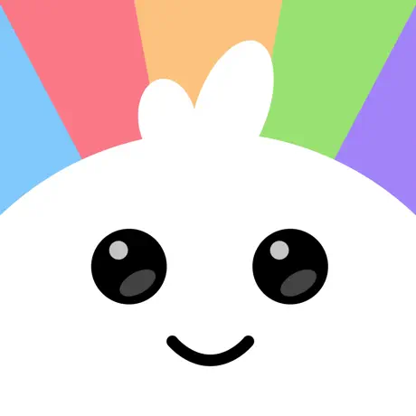

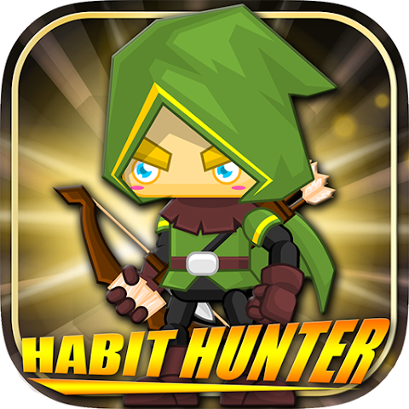

✔
✔
✔
✔
✔
✔
✔
✔
✔
✔
✔
✔
✔
✔
✔
✔
✔
✔
✔
Character Customization
Gamification
Narrative-Driven
Track Goals + Tasks
Connect with Others
Easy Onboarding

Slide 20
Values in Design

Slide 21
Values in Design
I.
II.
III.
IV.
V.
Playfulness
Reward Balance
Accessibility
Keep users coming back with entertaining stories and compelling cliffhangers
Set up in-game rewards that motivate users while curating intrinsic motivation and routine in their real-world tasks
Ensure Unfold is intuitive and usable for a broad user base with varying knowledge of games
Flexibility
Sustainability
Unfold should be applicable to users with all different kinds of tasks and goals
Motivation must be sustained over a long period for successful accountability—we need our users to be consistent and long-term
Notes:
Values in design a. List several direct and indirect stakeholders b. Present two ethical implications and your reflections on them

Slide 22
Direct/Indirect Stakeholders
Direct Stakeholders
Individuals who use Unfold to manage tasks, stay accountable, and progress through the narrative-driven experience
Indirect Stakeholders
Friends, Family, and Collaborators of the user that will be impacted by the user's task completion and productivity from the app's increase in user's productivity and accountability
Notes:
Values in design a. List several direct and indirect stakeholders b. Present two ethical implications and your reflections on them

Slide 23
Direct and Indirect Stakeholders
Users may feel pressure or anxiety from having to manage tasks on top of the story.
When a user already has a lot on their plate, they might find it stressful for their task managing app to have added features on top of it. As such, we prefer to reward success over punishing failures or mistakes.
We are looking into striking a balance between drafting both playful stories and compelling motivation for a user to continue.
In-app motivation might take away from in-person goals
If a user becomes very devoted to the reward system in the game, this can be detrimental or distracting to their intrinsic motivation. As such, we are working to not “over-gamify” the process such that the user doesn’t have to constantly interact or engage with the app.
We aim to create a reward system that encourages personal reflection and complements users’ motivations and goals.
Notes:
Values in design a. List several direct and indirect stakeholders b. Present two ethical implications and your reflections on them

Slide 24
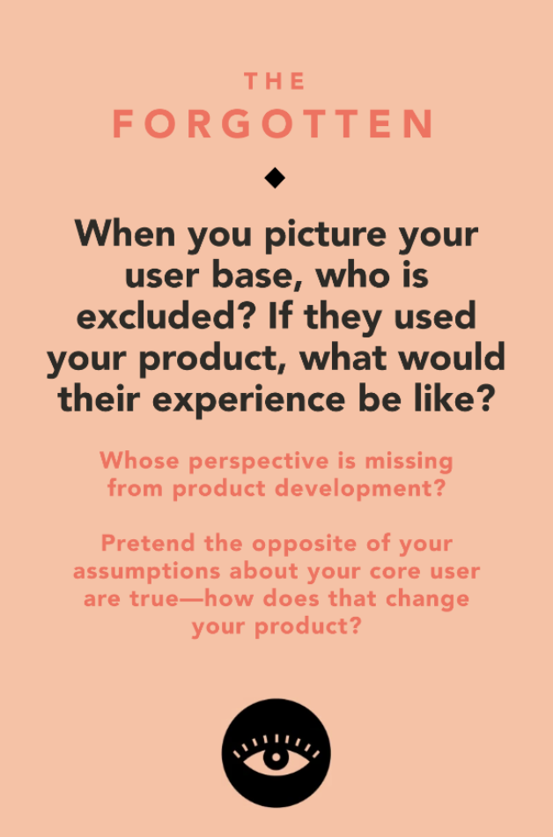
Ethical Implications
Users who do not typically enjoy gamification may feel pressure or anxiety from having to manage tasks on top of the story.
When a user already has a lot on their plate, they might find it stressful for their task managing app to have added features on top of it. As such, Unfold should be simple to learn and focus on rewarding success over punishing failures or mistakes.
We are looking into striking a balance between drafting both playful stories and compelling motivation for a user to continue.
Notes:
Values in design a. List several direct and indirect stakeholders b. Present two ethical implications and your reflections on them

Slide 25
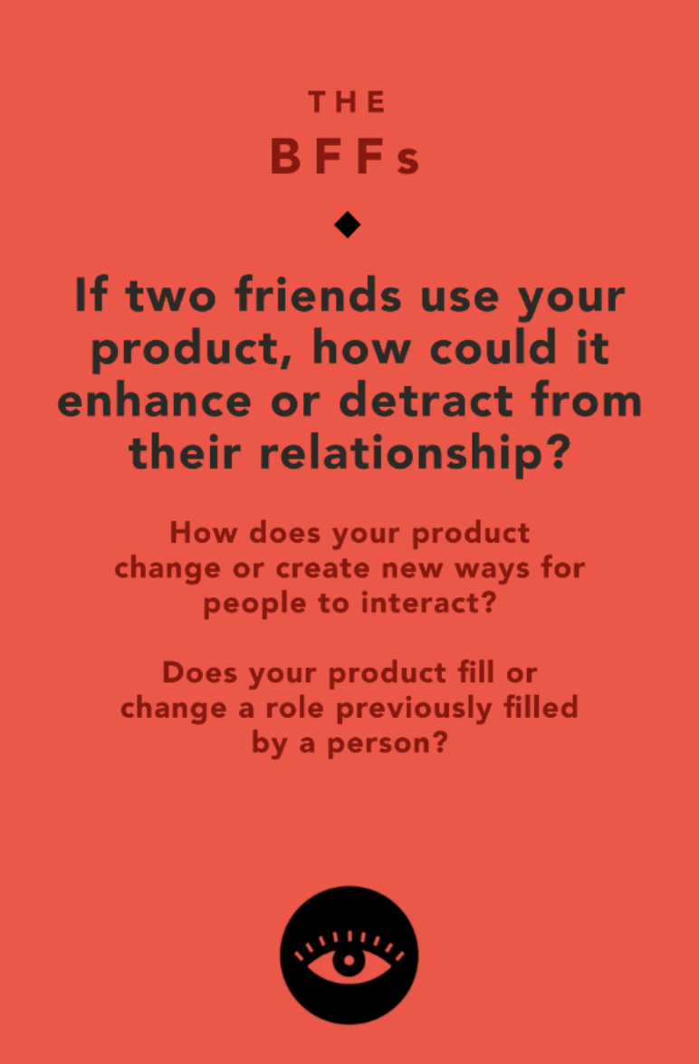
Ethical Implications
In-app motivation and the ability to compare digital avatars might make take away from in-person goals
If a user becomes very devoted to the reward system in the game, this can be detrimental or distracting to their intrinsic motivation as they are only checking off tasks to level up. As such, we are working to not “over-gamify” the process such that the user doesn’t have to constantly interact or engage with the app
We aim to create a reward system that encourages personal reflection and complements users’ motivations and goals
Notes:
Values in design a. List several direct and indirect stakeholders b. Present two ethical implications and your reflections on them

Slide 26
Tasks

Slide 27
Our Tasks
Simple
Moderate
Complex
User checks off a task that they completed.
User shares their stories with friends.
User customizes their personal character with items gained from story progression.
Notes:
3-5 tasks.
Label them as simple, moderate, or complex
Clear explanation why each is defined as simple, moderate, or complex
Time approximation of where in the video each task is being shown

Slide 28
Our Tasks
Why?
This is a common, straightforward task that requires minimal effort from the user
Checking off a task involves only one action: tapping or clicking a checkbox
No need for additional input or decision-making beyond acknowledging the completion of the task, making this task quick and easy for users to complete regularly
Simple
User checks off a task that they completed.
Video Time Stamps: 0:51-0:53, 1:07-1:10
Yellow Font
Notes:
3-5 tasks.
Label them as simple, moderate, or complex
Clear explanation why each is defined as simple, moderate, or complex
Time approximation of where in the video each task is being shown

Slide 29
Our Tasks
Why?
Sharing a story requires more effort and interaction compared to simply checking off a task
Users have to think about what they want to share, which adds a creative and reflective element to the task
Sharing a story involves an additional layer of complexity, as the user must not only create the story but also select the sharing mechanism (ex: choosing which friends to share with, platform options, etc.)
This task also involves another party (the friends), which adds a social aspect
Moderate
User shares their stories with friends.
Video Time Stamp: 1:35-1:42
Yellow Font
Notes:
3-5 tasks.
Label them as simple, moderate, or complex
Clear explanation why each is defined as simple, moderate, or complex
Time approximation of where in the video each task is being shown

Slide 30
Our Tasks
Why?
Customizing a character involves multiple decision-making steps, such as selecting items, changing appearance, and integrating items earned through the storyline
This task is more rare and requires additional input from the user, as they have to navigate menus, choose options, and possibly reflect on their character’s story progression before deciding on the customization
User unlocks items through progress in the app, which involves more interactions and creative-thinking
Complex
User customizes their personal character with items gained from story progression.
Video Time Stamp: 1:26-1:31
Yellow Font
Notes:
3-5 tasks.
Label them as simple, moderate, or complex
Clear explanation why each is defined as simple, moderate, or complex
Time approximation of where in the video each task is being shown

Slide 31
Storyboard

Slide 32
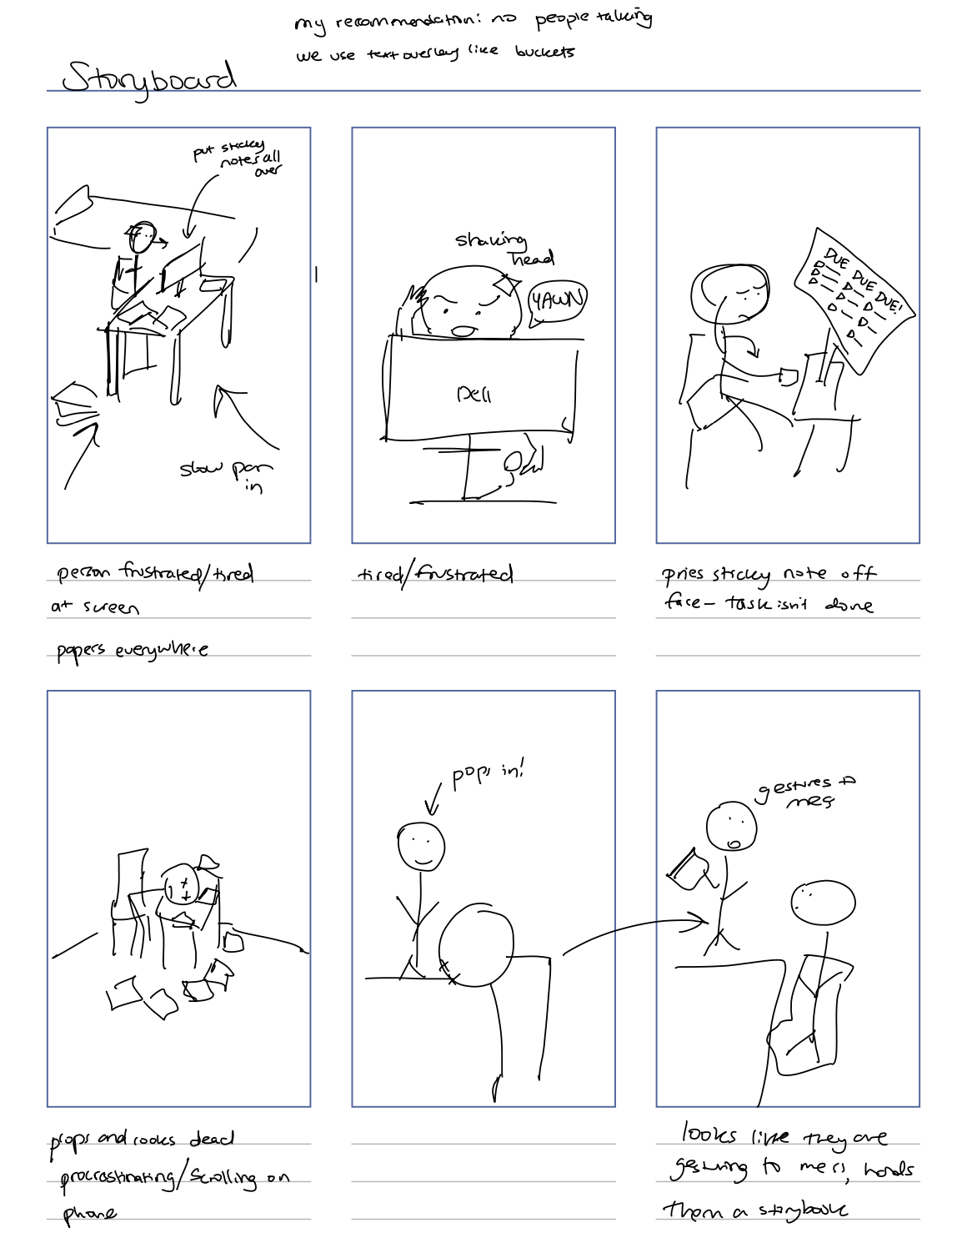
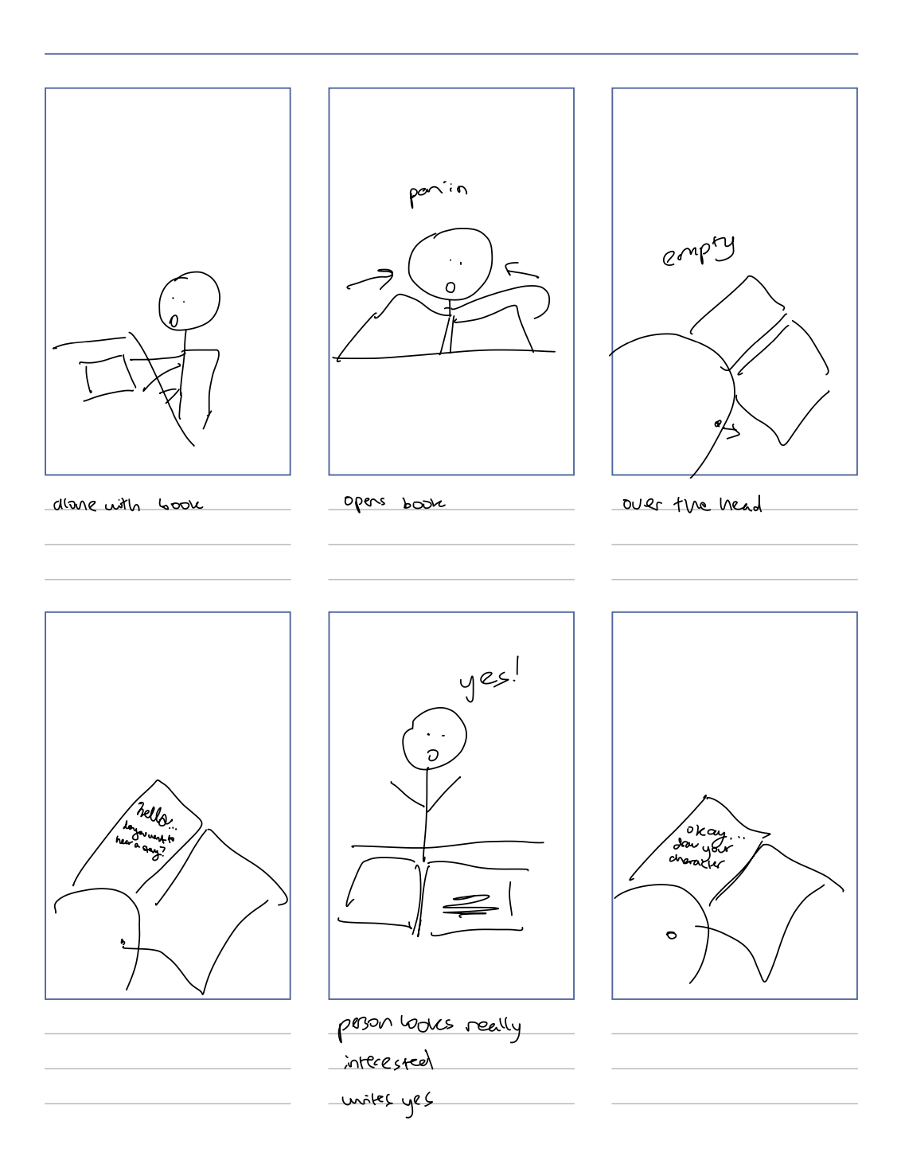
Instead of opting in, we had this part where we reveal “Unfold”
We decided to have the book pop in here magically

Slide 33
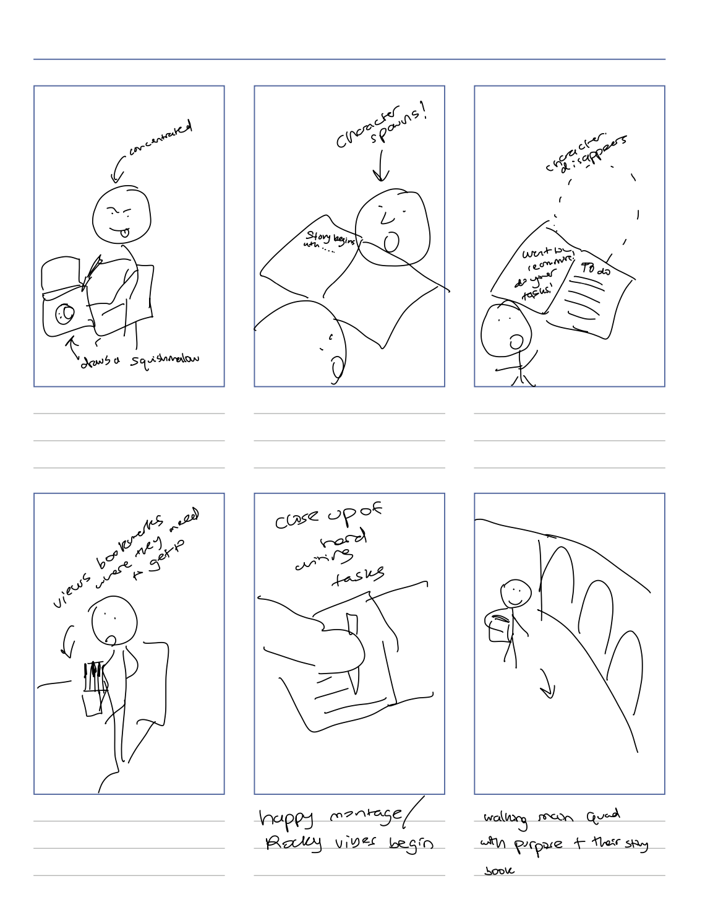
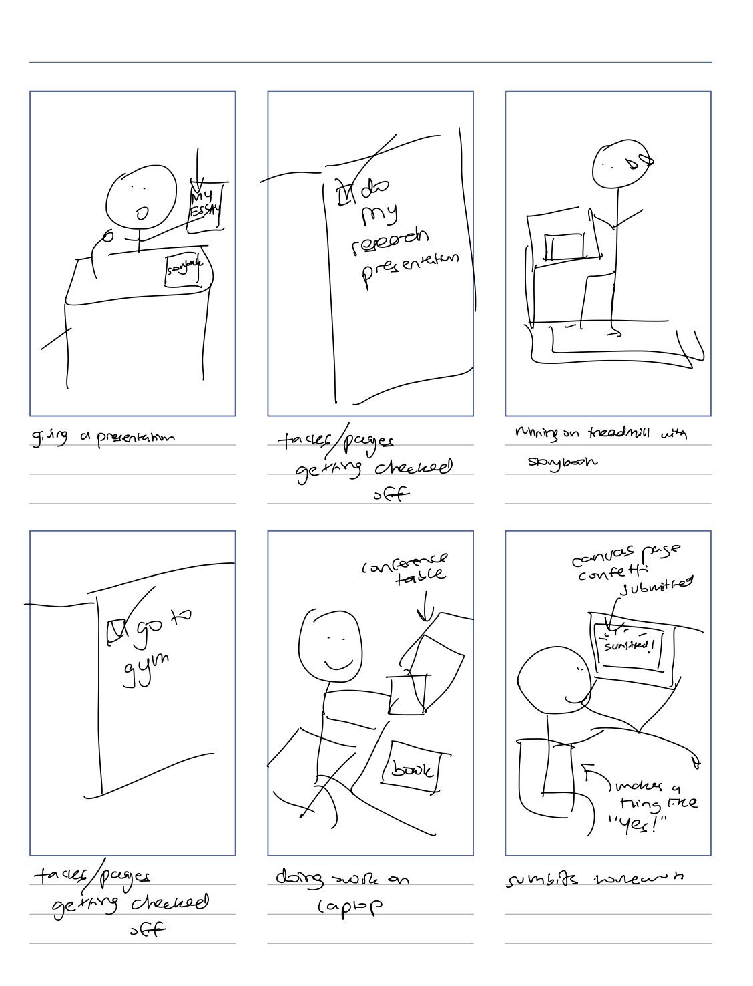
Key change: we added the storyline animation after character appears (see Appendix for Animation Storyboard)
In between character appearing / disappearing we wanted more comedy: the character makes the user fall to the ground
Instead of bookmarks, we wanted it more explicit: finish your pset to learn more

Slide 34
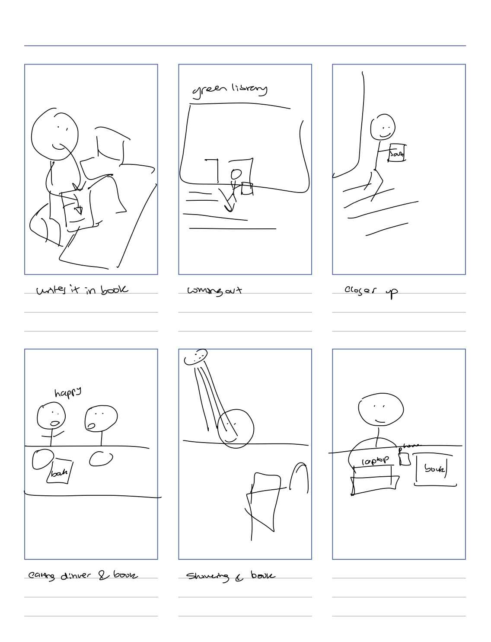
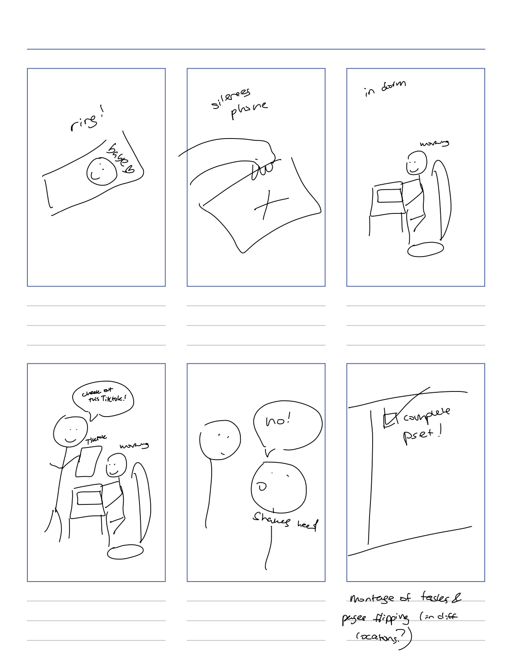
This scene was cut too (ending bae call was enough to show the lock-in)
We cut these scenes for times’ sake

Slide 35
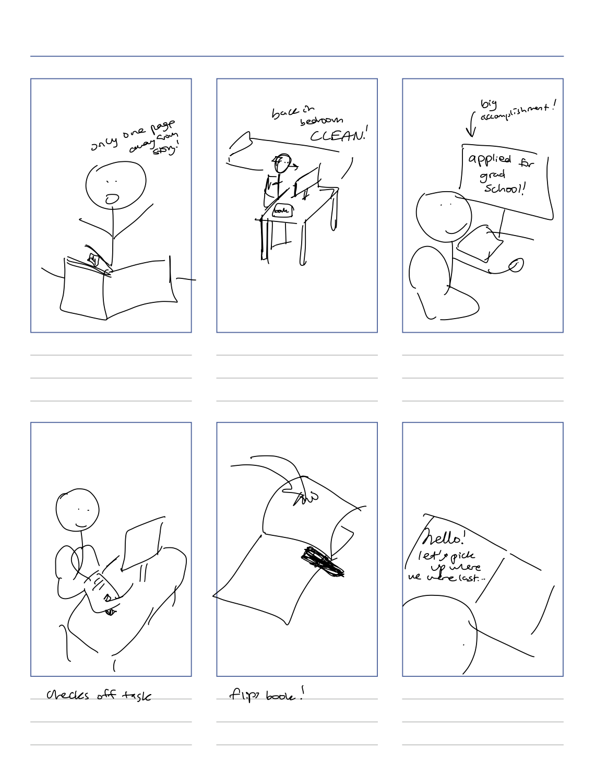
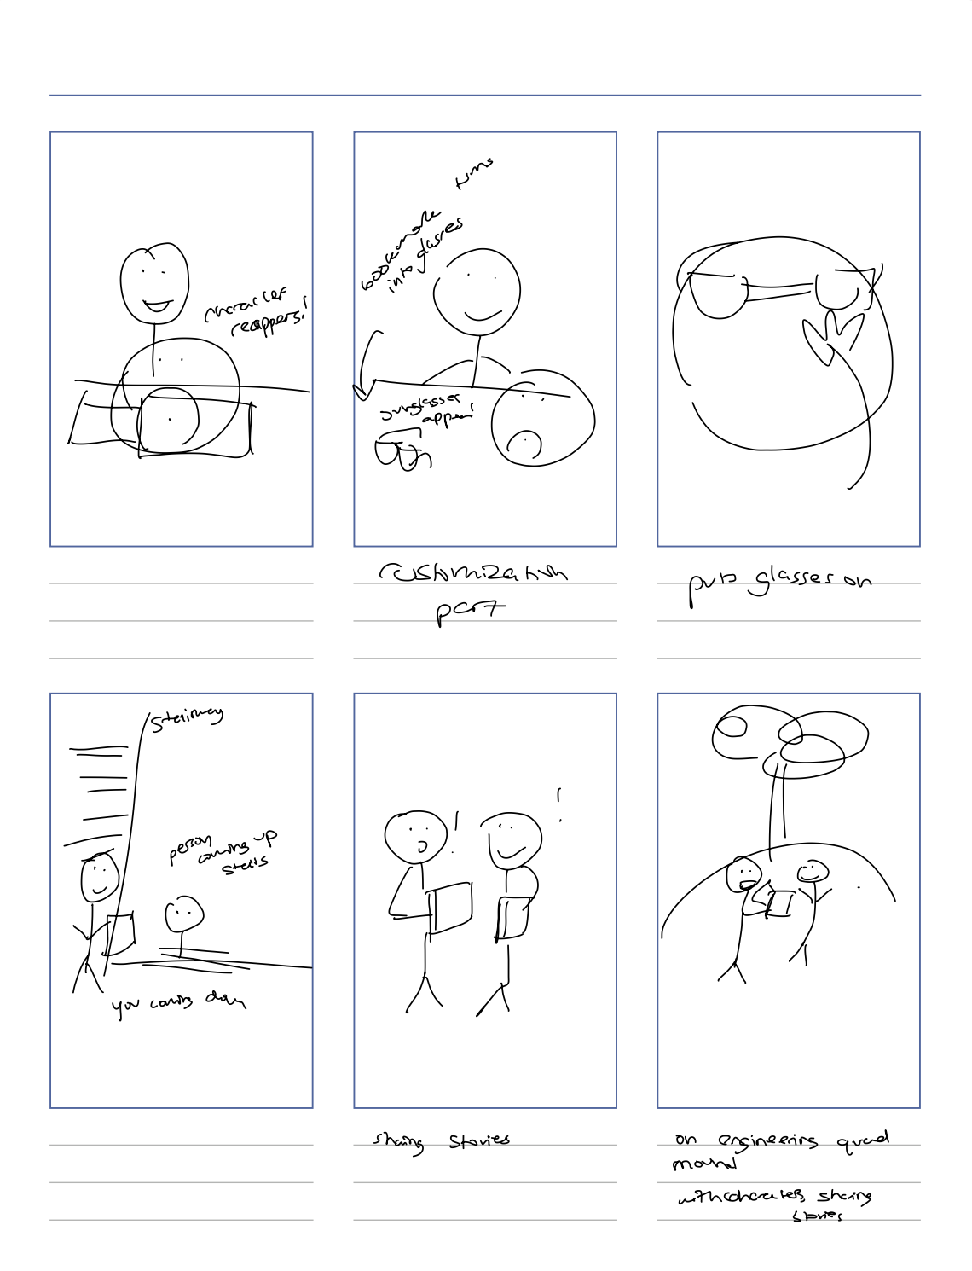
Added animation + in-person character customization scene
We had this be the Canva submission confetti
Delves into storyline (see Appendix)

Slide 36
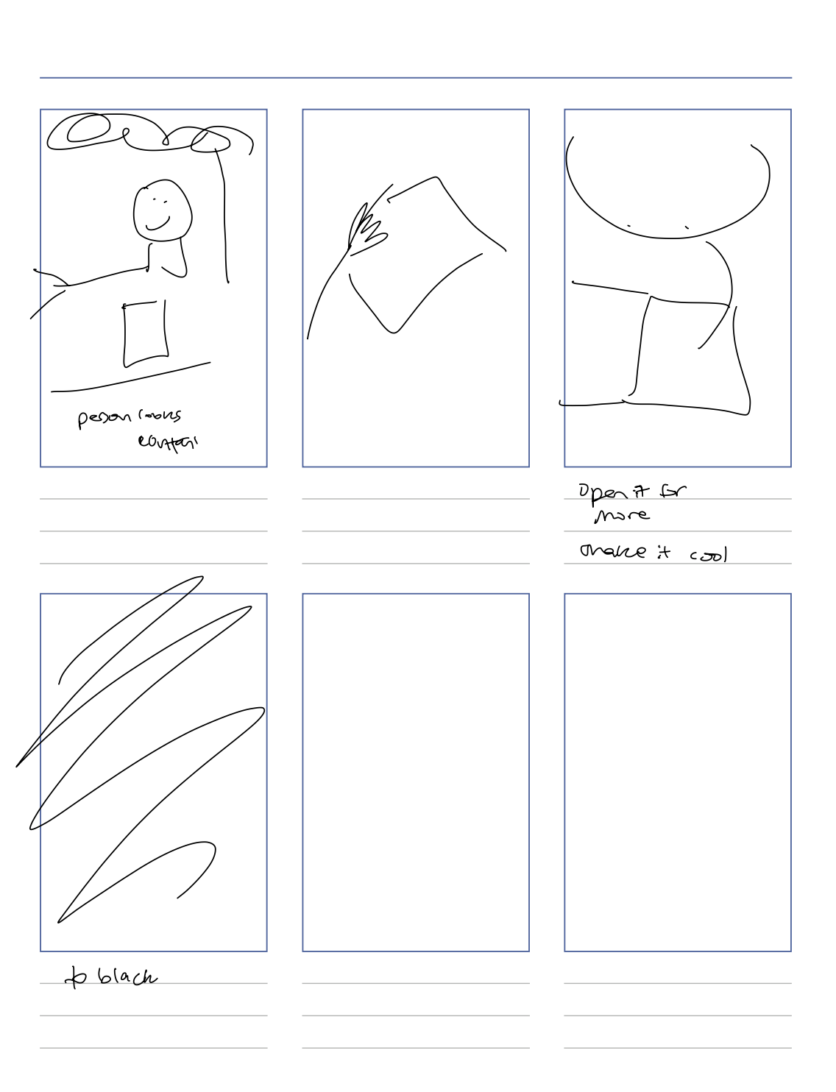
Instead the end is both people chatting: the connection

Slide 37
Our Video

Slide 38

https://youtu.be/DshLObv-ALE

Slide 39
Thank You!
A4: CONCEPT VIDEO
Notes:
3-5 tasks.
Label them as simple, moderate, or complex
Clear explanation why each is defined as simple, moderate, or complex
Time approximation of where in the video each task is being shown

Slide 40
Appendix

Slide 41
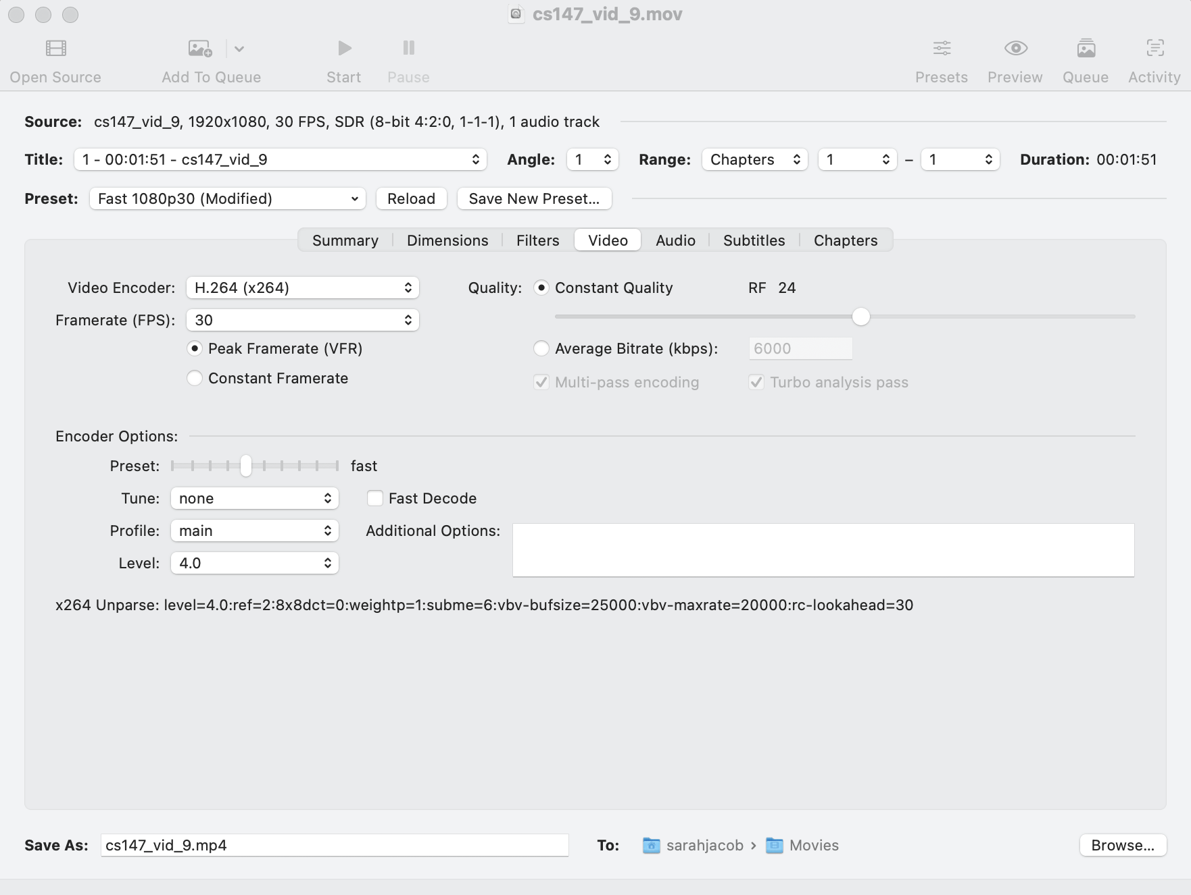
Used Handbrake

Slide 42
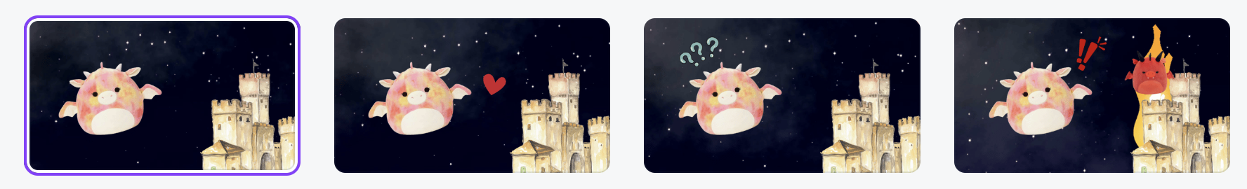
Animation Storyboard
Character sees castle
Character loves the castle (heart appears)
Character gets confused by the arrival of a red character (evil)
Character is shocked when the castle is set on fire! Red character disappears

Slide 43
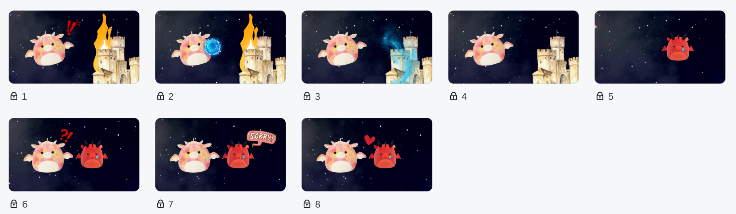
Animation Storyboard
Castle is on fire, character is alarmed
Character creates water power
Character throws at castle, flames extinguish
Character throws at castle, flames extinguish
Red character is sad
Character approaches red character, angry
Red character says sorry
Reconciliation

Slide 44
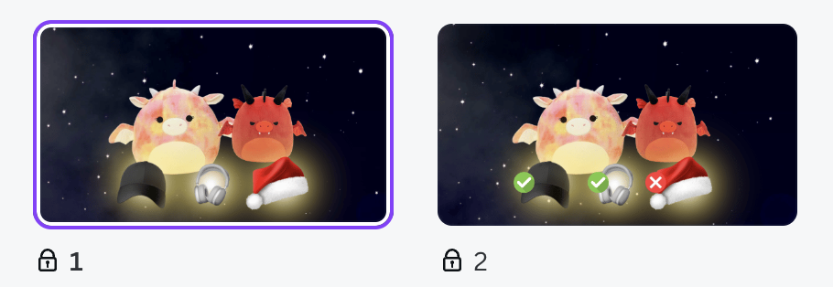
Animation Storyboard
Items appear gained from storyline progression
User chooses two of the three

